Slide 1

Real-Time Human Attribute Analysis Web Application
Neema Raiyat
Notes:
Hi, my name is Neema Raiyat and today I will be briefly summarising my third year project for you in this presentation.
Essentially we develop a web application capable of “Real-Time Human Attribute Analysis” (RTHAA, “ARTHUR” for short)

Slide 2
Real-Time Human Attribute Analysis (RTHAA) Web Application
Neema Raiyat
Notes:
ARTHUR as I’ll refer to it
And we’ll talk about what that exactly means
---
A brief outline of the presentation, we’ll begin talking about general field this project sits in and what it aims to achieve and why
Discuss design of the software created and of course demo it
Second half of the presentation is concerned with the more logistical aspects of the project

Slide 3

Introduction & Motivation
Notes:
(45s)
What is the ultimate goal of this project?
What are we trying to achieve here?
How does this fit into the wider scope of computing?

Slide 4
Human Computer Interaction (HCI)
Computers play an increasingly more dominant role within our lives
Becoming crucial to produce software that users enjoy
This project lies within HCI: We create a tool that measures a human’s emotions dynamically
We measure age and sex too
Notes:
Computers occupy an increasingly more dominant role in our lives. Almost always interfacing with a computer during our day, whether it’s work, so we can send emails to colleagues half way across the globe, entertainment, things like Netflix
So really, now more than ever is it important to produce software that users actually enjoy using, that improve the user experience. The key word there is ‘enjoy’, we want to be able to tell when developing software or really any product, aspects that the user might like and also dislike that way we can potentially cater the product to give the user the best possible experience.
And so therefore, investigating emotional responses induced by these products is clearly an object of interest for software developers and businesses more generally.
So this project lies within the broader sphere of human computer interaction. Ultimately, we want to improve the way users interface with digital systems and in this project, we do this by creating a tool that allows us to monitor a human’s impression of a digital system.
As well as emotions, we aim to measure other attributes like age and sex as they may provide useful data as to how different demographics interact with the system. e.g. Elderly people may find it harder to use software and hence may express more frustration. This could be picked up from the data this software retrieves.

Slide 5
More Applications…
Recommender Systems
Targeted advertisements
Personalised social media posts
Healthcare
Kaushik [1] - Help provide personalized treatment plans
Singh & Dewan [2] - Assist people with autism
Notes:
(1:40)
Human Attribute Recognition also has other applications outside of just product testing. As mentioned we can cater the system to suit the user more, here you can see for Recommendation Systems, we can have personalised advertisements, or perhaps suggest particular social media posts.
A paper by Kaushik showed that equipping a healthcare centre with surveillance systems that have the capability to recognise human emotions would be useful for helping them decide how certain patients respond to different treatments and see if their comfortable or not, and hence be able to provide a more personalized treatment plan.
Research paper by Singh and Dewan showed that using emotion recognition tools is very successful in helping people with autism, especially kids as that can be when their autism is the most problematic.
Especially children

Slide 6
Background
Notes:
What are the existing solutions that analyse human attributes?
What does our work add?

Slide 7
Existing Solutions
Noldus
MorphCast
iMotions
RTHAA (Our Work)
Unimodal
Web application
Image upload
Predicts age + sex
Unimodal
Web application
Real-time
Predicts age + sex
Unimodal
Desktop application (less accessible)
Real-time
Can’t predict age nor sex
Multimodal
Web application
Real-time
Predicts age + sex + speech sentiment + more analytical data
Helps user set up test environment with lighting detection
Notes:
Here we see the main existing tools for human attribute analysis: Noldus, MorphCast, iMotions
Unimodal - single independent channel of sensory input, in this case: visual, images (from a webcam, or by manually uploading images).
no phone users, needs updating, less flexible
RESTRICTIVE real-time so can be used in things like surveillance and product testing and the other use cases mentioned
So how does our work compare?
Why is this useful? more comprehensive and can analyse user experience more accurately because can look at both what the user is expressing through their face and also saying. Detection of more niche impressions, things like sarcasm, “Amazing” e.g. if the text sentiment is good but the expression is more neutral, we can begin to infer that theres a good chance the user is being sarcastic.
So in short, this project aims to create a tool that is more comprehensive than other current tools. Since this tool is made for the idea of testing products, it comes with the ability to detect lighting environment. MORE COMPREHENSIVE TESTING SUITE.

Slide 8
Design Overview
Notes:
(5:00)
What were the key design decisions made when developing?

Slide 9
Software Development Methodology
Scrum (Agile) Methodology:
Unstable requirements ⟹ Agile was chosen!
Many discrete features (emotion, age, sex, lighting etc.) ⟹ Incremental development
Each sprint would complete an item on the backlog (kanban board)
Elements of plan-driven approaches were adopted
Notes:
Requirements unstable, due to feasibility concerns, using a plan-driven approach like waterfall wouldn’t make sense, especially in the short time frame of the project, because a single change in requirements mean the entire project would have to be revamped.
lending itself to incrementally, hence an incremental / iterative methodology such as Scrum would allow for the production of prototypes and later minimum viable products (MVPs).
<>
Elements of plan-driven approaches were adopted Reuse-oriented software development, using various UI libraries would save some development time

Slide 10
Chosen Technologies
React.js (JavaScript Framework)
Large community ⟹ Many libraries
Efficient rendering ⟹ Strongest virtual Document Object Model (DOM) implementation [3]
Syntactic structure ⟹ Model-View-Controller (MVC) software architectural pattern
React.js is memory intensive [4]
Python (Analysis)
Used for model comparison ⟹ Sentiment analysis & facial emotion recognition
Wealth of machine learning libraries
Notes:
interactive, dynamic web application, JavaScript must be used.
React has a large community, large ecosystem, really well-maintained, with loads of useful libraries that one again reduce development overhead because it allows for us to take advantage of reuse-oriented software development methodology
Since we are making an application which dynamically displays data in real-time (has a lot of dynamic content), the page will be re-rendering a lot, and React is very efficient in that regard, as it uses a virtual DOM, meaning it essentially only updates the parts of the UI that need updating as opposed to re-rendering the entire page.
So in the context of the model view controller software architectural pattern, React is syntactically structured in a way that lends itself easily to separating the UI (view) and how to change it (controller), and of course any data stores needed in the process (model). This can make code easier to read, understand and maintain, and can help reduce the risk of errors.
However, React isn’t perfect, it’s memory intensive [7] – can be a concern for weaker devices, i.e. devices with limited computational resources
Python was also used for comparing different models and approaches for sentiment analysis and facial emotion recognition, Mainly chosen because it has many great libraries for machine learning and data visualization: TensorFlow, Matplotlib, etc.

Slide 11
Software Architectural Pattern: MVC
Model-View-Controller
Separates user interface (UI) from data processing
Easier to test ⟹ Clear interface to each component
All to make modification easier
Notes:
The software architectural pattern used was, as briefly mention earlier, Model-View-Controller (MVC) was used.
MVC separates the user interface (the view) part of the application from the data processing (controller) part of the application, meaning the UI can be easily changed without affecting the data logic, or the data itself – nice abstraction that separates implementation components (reducing code complexity and bugs)
The separation of the model, view and controller makes it easier to write automated tests for each component as the interface to each component is very clear
And all of this is an effort really to make modification to the application easier, because if you remember we have an agile methodology specifically because the requirements of the project were unstable, so we want to be able to make sure modification is as easy as possible as opposed to other architectural patterns which are more rigid like Pipe and Filter, and are more monolithic in structure.

Slide 12
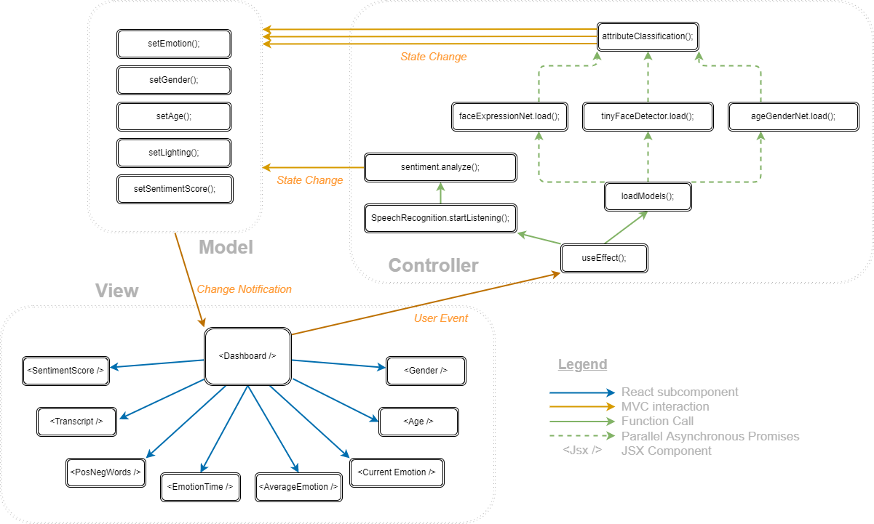
Software Architectural Pattern: MVC
Notes:
This is a simplified diagram of the how the MVC architectural pattern was implemented in the code, unfortunately I don’t have time to show how exactly it was implemented into the code
Explain legend (follows this kind of tree structure illuded to earlier when we looked at the virtual DOM, it has the same idea)
Explain JSX Component ⟹ Syntax extension to JavaScript that React has, and you can think of it as essentially a chunk of UI, a singular chunk of the user interface, and we’ll see what that looks like in the demo.

Slide 13


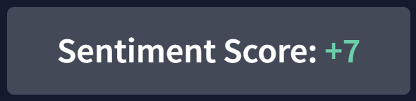
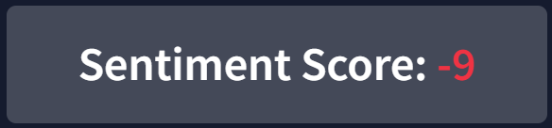
UI Design
Icon design based on Nielsen/Norman [5]:
Symbolism - Toggle Light/Dark Theme Button
Resemblance - Print collected user data button
Gestalt Principles - Similarity used in colour to denote purpose:
Sentiment Score
Web Content Accessibility Guidelines 2.1 international standard
Notes:
When it came to the design of the actual user interface, usability principles and heuristics from Nielson and Norman were used. Those are the two sets of fundamental principles that underpin UI design.
Gestalt principles are a more general theory of perception in psychology, it’s not restricted to just interfacing with a computer, but how we as human beings process visual information more generally.
Gestalt principle of similarity is used in the context of colour – this idea - Form informs function, green buttons usually signify begin, go, start, generally something good, whereas red usually signifies some sort of termination, or something bad.
And also, I don’t have time to show, but care was taken to ensure that we meet the current version (2.1) of the Web Content Accessibility Guidelines international standard.

Slide 14
Demonstration
Notes:
(10:00) WINDOWS+P
Gestalt principle of proximity
Usability principles: Nielson’s consistency principle have also been applied, Start button, clear data have similar functions, but top right
SHOW LIGHTING DETECTION!
SHOW LIGHT MODE!
Nielson’s Feedback principle is also used, for example when clicking the start button, that same button turns into the stop button (and changes colour) to let the user know that the web app is now processing data.
Show local demo with race detection ⟹ talk more about it later why it was decided to be removed

Slide 15
Project Management
Notes:
(13:00)

Slide 16
Project Management Methodology
Scrumban (Scrum + Kanban)
Lean and agile principles:
Kanban Board (Lean)
Limit number of tasks ⟹ Reduces task-switching overhead
Pull-system ⟹ Focus is on prioritising ⟹ Prevent scope creep
Minimum Viable Products (Agile)
User feedback is received earlier
Notes:
(13:00)
The combination of the two allow us to employ both lean and agile principles (Lean being Less time planning and forecasting, more time doing!)
Easier to focus on one thing and do that one thing really well as opposed to constantly context switching, helps streamline the flow of production
Pull-system – i.e. only complete what is required so focus is on prioritising, preventing wasteful scope creep (minimize waste ⟹ lean philosophy)
Allows integration of user feedback early into the development process
Proved especially useful in developing the UI
Each 2-week sprint would produce an MVP
Scrum is itself a lean approach because it emphasises principles like, continuous improvement, flexible to change

Slide 17
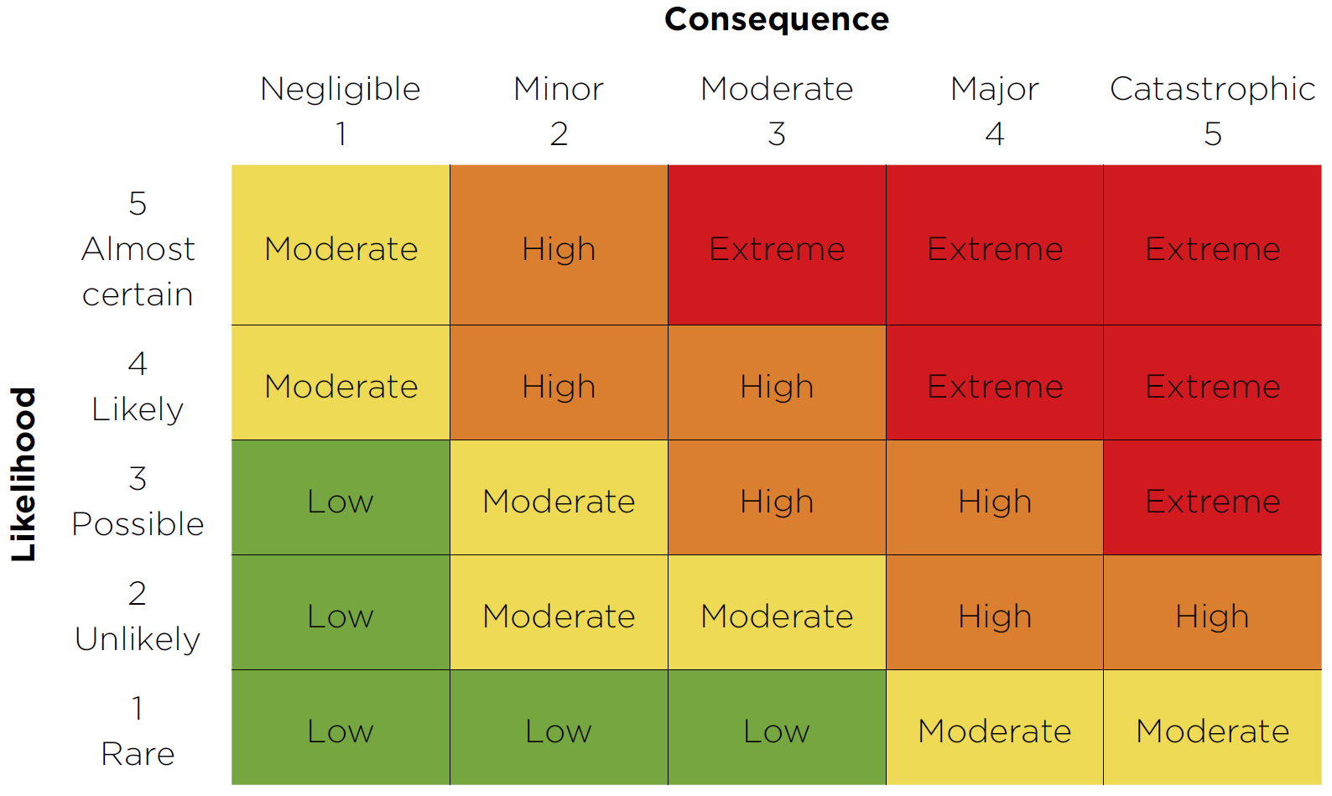
Risk Management
Strict deadlines + sizeable documentation ⟹ Risk-averse approach was taken.
Risk Matrix:
Notes:
Due to the strict deadlines this project entails, and the sizeable amount of documentation needed to be produced, the biggest risk identified was running out of time
Here you can see this project’s Risk Matrix showing the risk-averse appetite this project adopted, by there being more darker, redder colours than greener, lighter colours

Slide 18
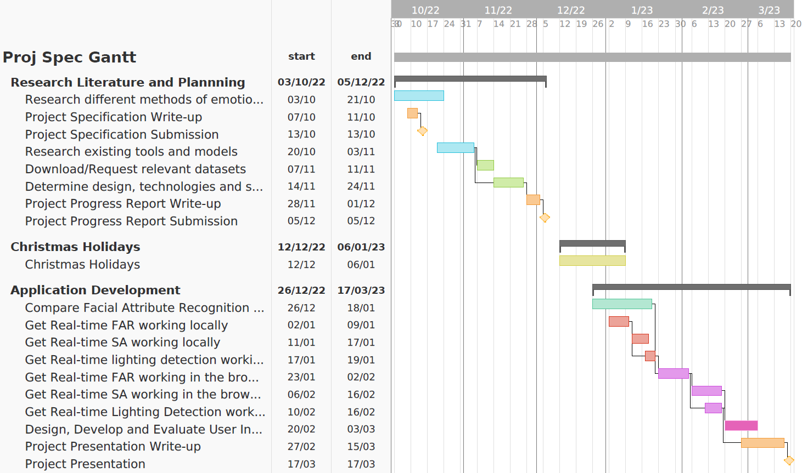

Time Management: Planned
Notes:
The project was split into two phases: Research + Planning phase (Term 1), and the Software Development (Term 2).
This is the Gantt chart to show how the project was planned, and ideally, when each part of the project would be completed

Slide 19
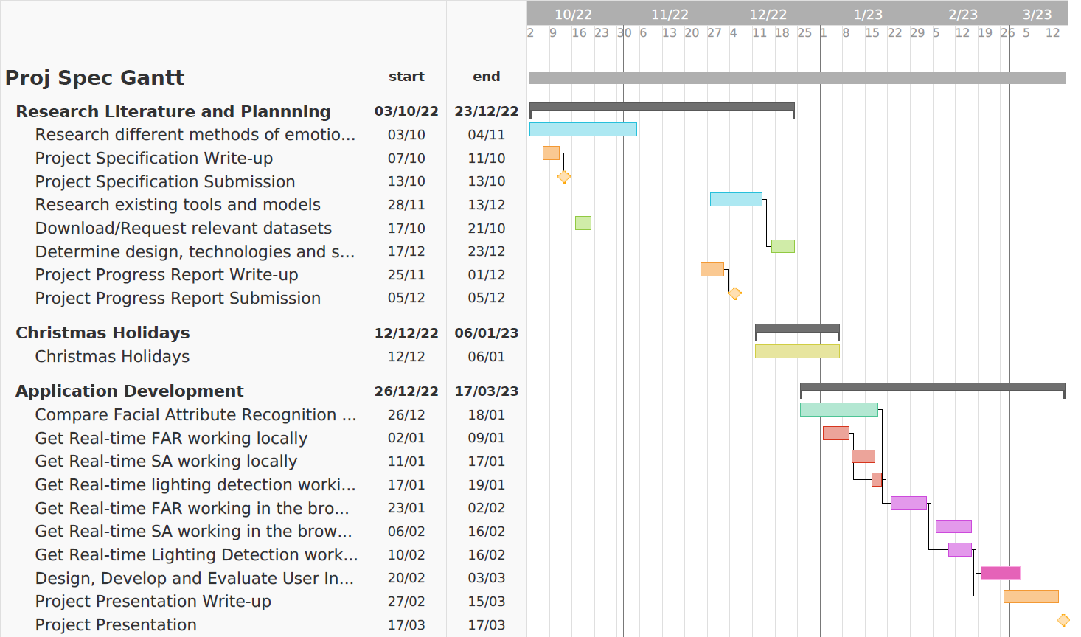
Time Management: Execution
Notes:
Here is the actual execution, Term 1, little progress was made due to external factors, other modules, internships so and so forth, however this was compensated for during this Christmas break, so you can see here that some tasks were in actuality completed over the Christmas holidays as shown by that yellow bar (point out overarching black bar now leaks into Christmas black bar). Term 2 however, everything remained more on less on time.

Slide 20
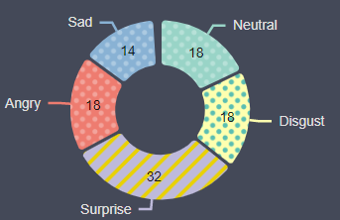
Unforeseen Problems
Problem: Using a backend for image classification. Too slow!
Detected: Average classification time: 8 seconds
Overcome: Machine learning was done in the front-end
Problem: Visibility/contrast problems in light mode for colour-blind users
Detected: User testing with colour-blind users
Overcome: Colour palette was overhauled + textures were also added.
Notes:
Here are just a small selection of some of the unforeseen problems overcome, unfortunately I don’t have time to delve into the more interesting ones.
Existing solutions are under 2 seconds.
Various UI design issues, one of which being: colourblind users. And even for users who weren’t colourblind, the text was still hard to read as the text itself was light in colour!
This issue was detected earlier on because of scrum allowing us to produce MVPs and integrate user feedback early into the process

Slide 21
Evaluation & Conclusion
Notes:
(16:00)

Slide 22
Evaluation & Conclusion
12 participants tested the existing solutions and RTHAA
Questions included:
Which application do you feel best identified your attributes?
Better user experience? – Which is easier to use?
Overall preferred application?
In conclusion, project is a success!
All requirements in specification complete!
Notes:
12 Participant’s were made to try Noldus, MorphCast, iMotions and RTHAA (our project)
Participant’s not aware which product was which ⟹ Minimize cognitive bias
minimize any cognitive bias introduced (systematic errors), family, flatmates, friends
Ideally this would be tested on more people, but you can still see a strong trend favouring our work, especially when it comes to user experience

Slide 23
Limitations & Future Work
Notes:
(17:00)

Slide 24
Limitations & Future Work
Limitations include:
Real-time sentiment analysis does not work on Firefox
People with monochromatism will struggle using the application
Future work may involve:
Use a polyfill - host a speech recognition service
Add hover styling which shows which emotion the user’s mouse is on
Notes:
SAFARI, CHROMIUM BASED BROWSER e.g. EDGE
Speech recognition library used doesn’t work on Firefox, This is because firefox doesn’t natively support google’s speech recognition servers
Add hover styling which shows which emotion the user’s mouse is on
Host your own speech recognition server which implements the Web Speech API so that the react-speech-recognition library can talk to it.
Using tone of voice to determine sentiment
TONE – words aren’t needed, sighs, yawns etc.
All of this, in an effort to provide as much analytical data as possible

Slide 25
Ethical Considerations

Slide 26
Ethical Considerations
Race detection was removed ⟹ Could warrant racially motivated behaviour
Privacy
Processing of data must be done transparently - Data Protection Act [6]
Race is classified as very sensitive information
Risk that attribute technology may be biased
⟹ Could result in unfair or discriminatory outcomes
Notes:
People’s attributes should be recorded only if consent is given
The data protection act formed in 2018, which is essentially the UK’s implementation of the General Data Protection Regulation (GDPR) now that the UK has left the European Union
EXPLICIT CONSENT - DPA has this notion of - Lawfulness, Fairness, and Transparency
They should be made aware of what data is being collected, where it will be used, how it will be used, and who will have access to it.
Race/ethnicity is specifically categorized as very sensitive information as it could be used to individually identify people, so once again, explicit consent, oral or written is needed.
When it comes to the actual processing of data, bias could be a big problem
Care must be taken to ensure IID (Independent and Identically distributed dataset) – So if the datasets used when training models are not representative of the diverse population, could result in unfair or discriminatory outcomes, and generally unwanted bias is introduced.

Slide 27
References
[1] Kaushik, Patient Monitoring Using Emotion Recognition, 2022, https://www.ijraset.com/best-journal/patient-monitoring-using-emotion-recognition
[2] Singh, AutisMitr: Emotion Recognition Assistive Tool for Autistic Children, 2020, https://doi.org/10.1515/comp-2020-0006
[3] x-team, React vs Angular, 2021, https://x-team.com/blog/react-vs-angular/
[4] synergycodes, Angular vs. React. Which technology is more efficient?, 2021, Accessed: March 5, 2023, https://synergycodes.com/blog/angular-vs-react-which-technology-is-more-efficient/
[5] Nielson Norman Group, Icon Classification: Resemblance, Reference, and Arbitrary Icons, 2014, Accessed March 13, 2023, https://www.nngroup.com/articles/classifying-icons/
[6] UK, The Data Protection Act, 2018, Accessed: March 13, 2023 , https://www.gov.uk/data-protection

Slide 28
Questions?
End of Presentation

Slide 29
Conclusion
In conclusion, the project is a success! - All requirements in specification complete!
MUSTs:
Emotions detected with high degree of accuracy (similar to that of existing solutions)
Real-time (at most 2 seconds per response)
Multi-modal – User verbal input for sentiment analysis
SHOULDs:
Data visualization for analysis
Detect other attributes, namely age and sex
COULDs:
Assist user in setting up test environment (lighting detection)
Notes:
All Must, should and coulds were completed, however the project clearly isn’t perfect
All deliverables were done on time!
And we managed to create a tool, a web app, that was genuinely more comprehensive and useful than existing tools in the field of Human Attribute Recognition.

Slide 30
Limitations & Future Work
Limitations include:
Real-time sentiment analysis does not work on Firefox (but does on Chrome, Safari and Edge)
Solution: Use a polyfill - host a speech recognition service and implement Web Speech API
If the user is completely colour-blind (Monochromacy), they will not be able to use the application
Solution: Add hover styling which shows which emotion the user’s mouse is on
As well as remediating limitations, future work may involve:
Adding Face Mesh for landmark detection
Using Tone of voice to determine sentiment (classify audio)
Face feature detection: Glasses, beard, moustache etc.
Notes:
Be aware of solutions, maybe remove. Future work has solutions + tone of voice
Due to the speech recognition library used, SA doesn’t work on firefox, This is because firefox doesn’t natively support google’s speech recognition servers and so you have to host your own speech recognition server which implements the Web Speech API so that the react-speech-recognition library can talk to it.
All of this, in an effort to provide as much analytical data as possible

Slide 31
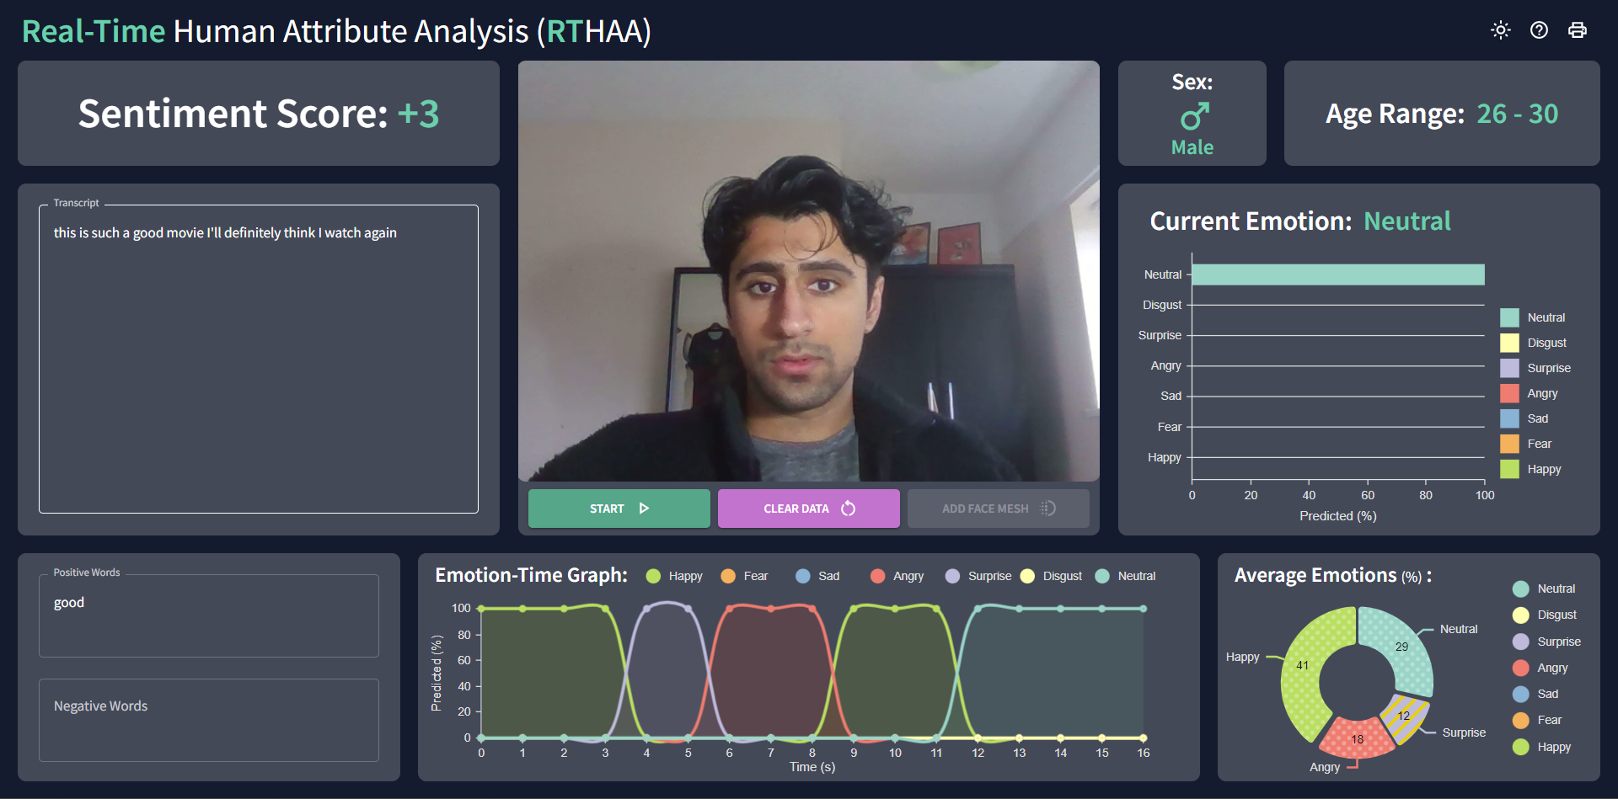
UI Design

Slide 32
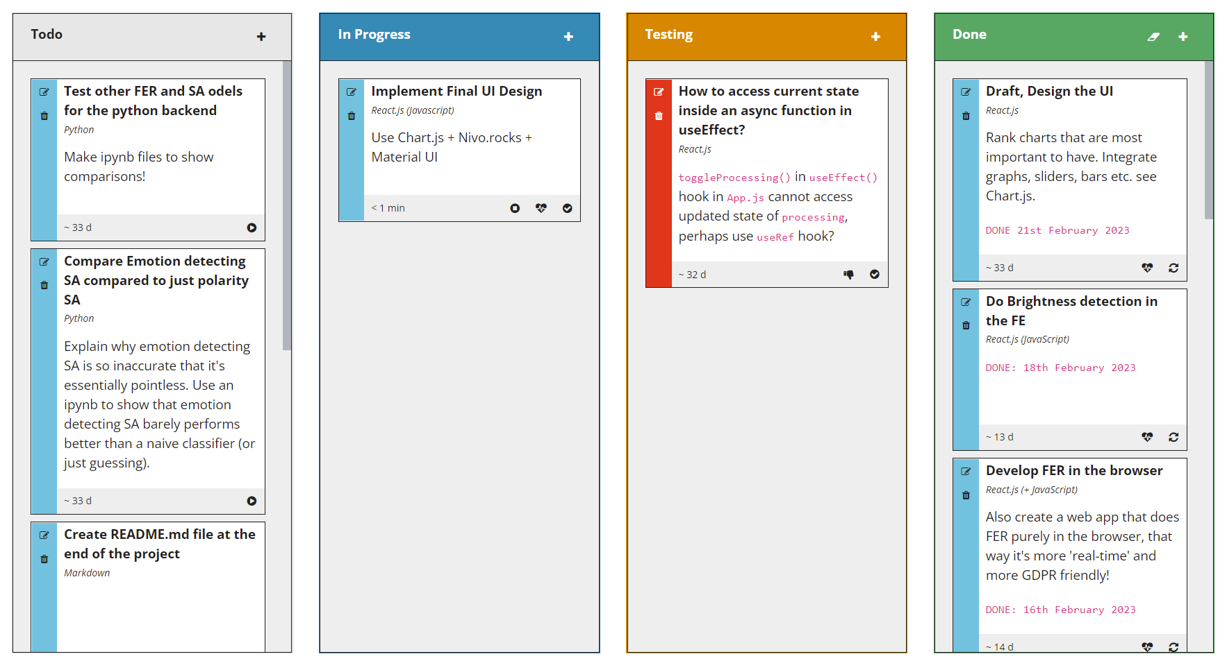
Kanban Board
Notes:
SHOULD I BOTHER SHOWING THIS?? USER STORY FORMAT?
SPLIT PREV SLIDE INTO 2???

Slide 33
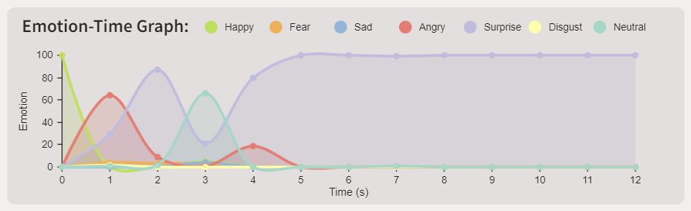
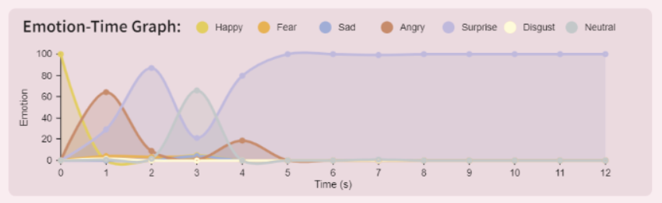
Unforeseen Problems
Trichromatic View (no colour-blindness)
Deuteranomaly (most common type of red-green colour blindness)
Notes:
So now, you can see in light mode, colours are still distinguishable
Green there is now yellow/orange but still distinguishable from the other emotions
DON’t BOTHER

Slide 34
Summary
Notes:
SHOULD I HAVE THIS SLIDE?

Slide 35
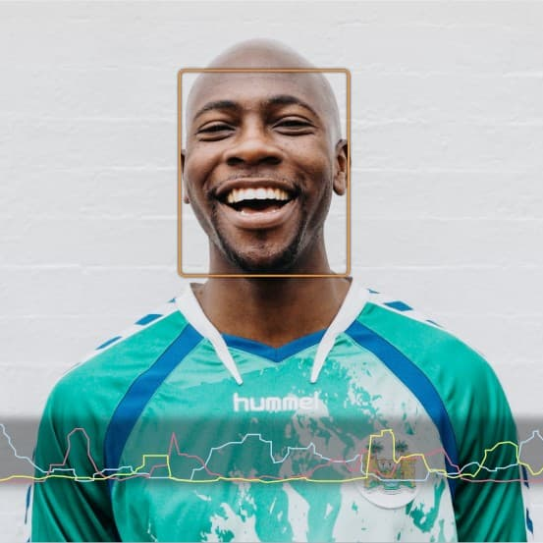
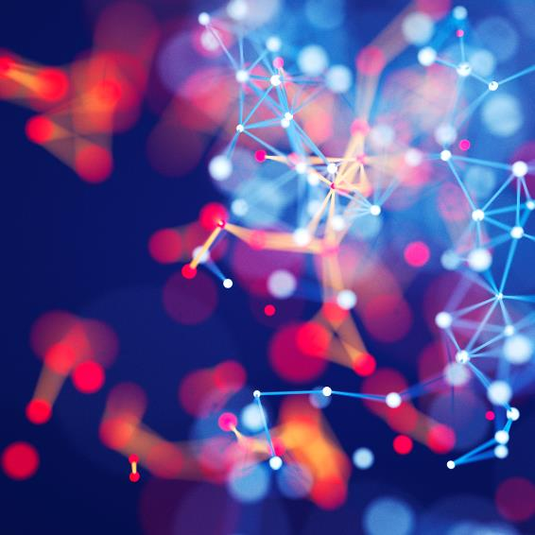
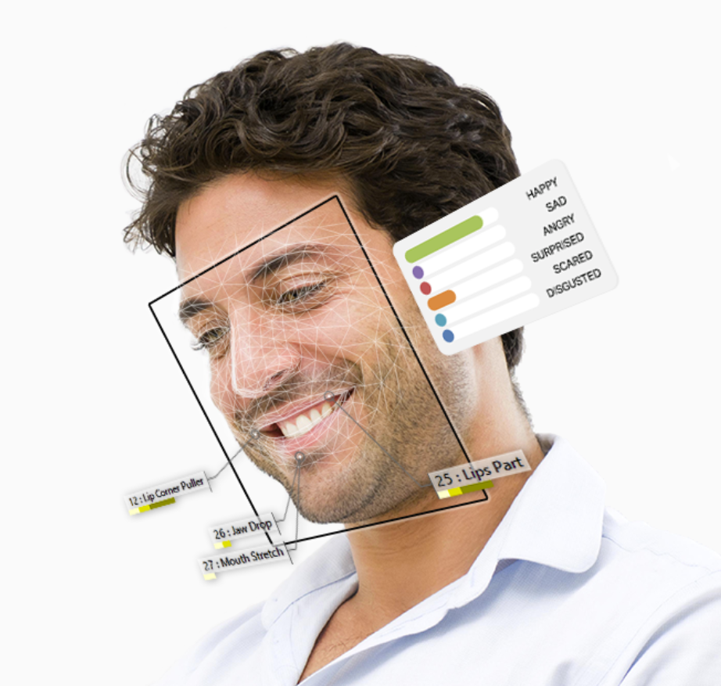
Contents
Introduction and Motivation
Background
Design Overview
Demonstration
Project Management
Conclusion & Evaluation
Limitations & Future Work
Ethical Considerations
Notes:
So in this presentation we’ll begin talking about general field this project sits in and what it aims to achieve and why
Discuss design of the software created and of course demo it
Second half of the presentation is concerned with the more logistical aspects of the project
REOMVE CONTENTS

Slide 36
References
Evaluation – Everything + extensions achieved
User stories for evaluation
Notes:
Since this is an interactive web application, JavaScript must be inevitably used as that’s the scripting language that most common browsers interpret. The JavaScript framework chosen was React.js. Other existing frameworks include Angular.js as well as Vue.js. React.js was chosen as it is well-maintained, great for single-page applications and has efficient rendering performance as it uses a virtual document object model meaning it only updates part of the UI/parts of the DOM that have actually changed.

Slide 37
Chart

Slide 38
Why multimodal is important
Subtitle
Subtitle
Add text, images, art, and videos.
Add transitions, animations, and motion.
Save to OneDrive, to get to your presentations from your computer, tablet, or phone.
Open the Design Ideas pane for instant slide makeovers.
When we have design ideas, we’ll show them to you right there.

Slide 39
Table
 | Category 1 | Category 2 | Category 3 | Category 4
Item 1 | 4.5 | 2.3 | 1.7 | 5
Item 2 | 3.2 | 5.1 | 4.4 | 3
Item 3 | 2.1 | 1.7 | 2.5 | 2.8
Item 4 | 4.5 | 2.2 | 1.7 | 7

Slide 40

The way to get started is to quit talking and begin doing.
Walt Disney

Slide 41




Team
Name
Name
Name
Name
Title
Title
Title
Title

Slide 42
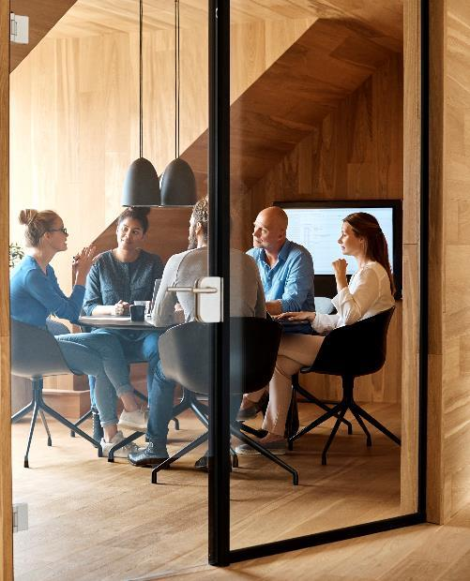


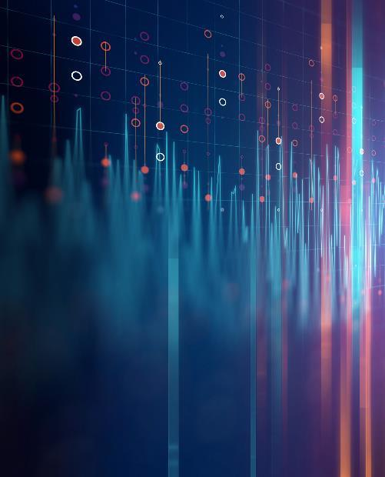
Demonstration
.

Slide 43
Timeline
Title
To start a presentation, go to the Slide Show tab, and select From Beginning.
Title
To display Presenter view, in Slide Show view, on the control bar at the bottom left select the three dots, and then Show Presenter View.
Title
During your presentation, the speaker notes are visible on your monitor, but aren't visible to the audience.
Title
Title
If you can’t see the Notes pane or it is completely minimised, click Notes on the task bar across the bottom of the PowerPoint window.
The Notes pane is a box that appears below each slide. Tap it to add notes.

Slide 44
Content
Subtitle
Subtitle
Add text, images, art, and videos.
Add transitions, animations, and motion.
Save to OneDrive, to get to your presentations from your computer, tablet, or phone.
Open the Design Ideas pane for instant slide makeovers.
When we have design ideas, we’ll show them to you right there.

Slide 45
Content 2
Subtitle
subtitle
subtitle
Add text, images, art, and videos.
Add transitions, animations, and motion.
Save to OneDrive, to get to your presentations from your computer, tablet, or phone.
Open the Design Ideas pane for instant slide makeovers.
When we have design ideas, we’ll show them to you right there.
Add text, images, art, and videos.
Add transitions, animations, and motion.
Save to OneDrive, to get to your presentations from your computer, tablet, or phone.
Open the Design Ideas pane for instant slide makeovers.
When we have design ideas, we’ll show them to you right there.
Add text, images, art, and videos.
Add transitions, animations, and motion.
Save to OneDrive, to get to your presentations from your computer, tablet, or phone.
Open the Design Ideas pane for instant slide makeovers.
When we have design ideas, we’ll show them to you right there.

Slide 46
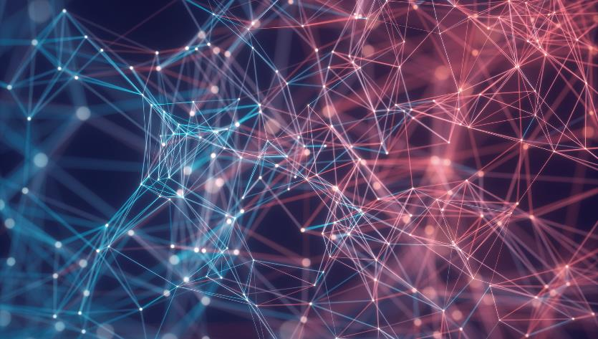

Thank You
Presenter name
Email address
Website address

